Slide 1































INT104 – Database Management System Unit – III

Slide 2

Transaction States
Additional Operations
System log
Buffer Replacement Algorithms

Slide 3
Additional Operations
DBMS Recovery Manager needs system to keep track of the following operations (in the system log file):
begin_transaction:
Start of transaction execution.
read or write:
Read or write operations on the database items that are executed as part of a transaction.

Slide 4
Additional Operations
end_transaction:
Specifies end of read and write transaction operations have ended.
System may still have to check whether the changes (writes) introduced by transaction can be permanently applied to the database (commit transaction);
whether the transaction has to be rolled back (abort transaction) because it violates concurrency control or for some other reason.

Slide 5
Additional Operations
commit_transaction:
Signals successful end of transaction;
any changes (writes) executed by transaction can be safely committed to the database and will not be undone.
abort_transaction (or rollback):
Signals transaction has ended unsuccessfully;
any changes or effects that the transaction may have applied to the database must be undone.

Slide 6
Transaction States
A transaction passes through several states
Figure (next slide) similar to process states in operating systems
Transaction states:
Active state (executing read, write operations)
Partially committed state (ended but waiting for system checks to determine success or failure)
Committed state (transaction succeeded)
Failed state (transaction failed, must be rolled back)
Terminated State (transaction leaves system)

Slide 7
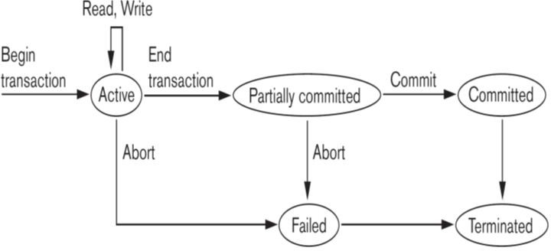
State transition diagram illustrating the states for transaction execution

Slide 8
The System Log File
To be able to recover from failures that affect transactions
The system maintains a log file
log is an append-only file
Keep track of all operations of all transactions in the order in which they occurred.
Log is kept on disk
not affected except for disk or catastrophic failure
As with other disk files
a log main memory buffer is kept for holding the records being appended until the whole buffer is appended to the end of the log file on disk
Log is periodically backed up to archival storage (tape) to guard against catastrophic failures

Slide 9
Types of records (entries) in log file:
[start_transaction,T]:
Records that transaction T has started execution.
[write_item,T,X,old_value,new_value]:
T has changed the value of item X from old_value to new_value.
[read_item,T,X]:
T has read the value of item X (not needed in many cases).
[end_transaction,T]:
T has ended execution
[commit,T]:
T has completed successfully, and committed.
[abort,T]:
T has been aborted.

Slide 10
Commit Point of a Transaction
A transaction T reaches its commit point
when all its operations that access the database have been executed successfully
the effect of all the transaction operations on the database has been recorded in the log file (on disk).
The transaction is then said to be committed.

Slide 11
Commit Point of a Transaction
Log file buffers:
Like database files on disk, whole disk blocks must be read or written to main memory buffers.
For log file, the last disk block (or blocks) of the file will be in main memory buffers to easily append log entries at end of file.
Force writing the log buffer:
Before a transaction reaches its commit point
Any main memory buffers of the log that have not been written to disk yet must be copied to disk.
Called force-writing the log buffers before committing a transaction.
Needed to ensure that any write operations by the transaction are recorded in the log file on disk before the transaction commits

Slide 12

DBMS-Specific Buffer Replacement Policies

Slide 13
DBMS-Specific Buffer Replacement Policies
The DBMS cache will hold the disk pages that information currently being processed in main buffers.
contain memory
If all the buffers in the DBMS cache are occupied
New disk pages are required to be loaded into main memory from disk
A page replacement policy is needed to select the particular buffers to be replaced.
Some page replacement policies that have been developed specifically for database systems.

Slide 14
Domain Separation (DS) Method.
In a DBMS, various types of disk pages exist:
index pages, data file pages and log file pages.
In this method
the DBMS cache is divided into separate domains (sets of buffers).
Each domain handles one type of disk pages
Page replacements within each domain are handled via the basic LRU (least recently used) page replacement.
Although this achieves better performance on average that basic LRU, it is a static algorithm, and so does not adapt to dynamically changing loads because the number of available buffers for each domain is predetermined.

Slide 15
Domain Separation (DS) Method.
Several variations of the DS page replacement policy have been proposed, which add dynamic load-balancing features.
For example,
the GRU (Group LRU) gives each domain a priority level
selects pages from the lowest-priority level domain first for replacement
whereas another method dynamically changes the number of buffers in each domain based on current workload.

Slide 16
Hot Set Method
This page replacement algorithm is useful in queries that have to scan a set of pages repeatedly
when a join operation is performed using the nested-loop method
If the inner loop file is loaded completely into main memory buffers without replacement (the hot set)
The join will be performed efficiently because each page in the outer loop file will have to scan all the records in the inner loop file to find join matches.
The hot set method determines for each database processing algorithm
the set of disk pages that will be accessed repeatedly
it does not replace them until their processing is completed.

Slide 17
The DBMIN Method
This page replacement policy uses a model known as QLSM
(query locality set model)
predetermines the pattern of page references for each algorithm for a particular type of database operation.
Depending on the
Type of access method
The file characteristics
The algorithm used
The QLSM will estimate the number of main memory buffers needed for each file involved in the operation.

Slide 18
The DBMIN Method
The DBMIN page replacement policy
will calculate a locality set
using QLSM for each file instance involved in the query (some queries may reference the same file twice)
DBMIN then allocates the appropriate number of buffers to each file instance involved in the query based on the locality set for that file instance.
The concept of locality set is analogous to the concept of working set, which is used in page replacement policies for processes by the operating system but there are multiple locality sets, one for each file instance in the query.

Slide 19

Transaction States
System log
Buffer Replacement Algorithms
DS
Hot Set
DBMIN

Slide 20


